Slide 1

DNS Cache Poisoning and Spoofing

Slide 2
Content
What is DNS?
How DNS works?
What is DNS Cache?
What is DNS Spoofing/Poisoning.
DNS Cache Poisoning Attack.
DNS Poisoning Tools.
How To Prevent DNS Cache Poisoning Attack?
Aims of attackers
Methods to Conduct DNS spoofing .
How to remove Poison?

Slide 3
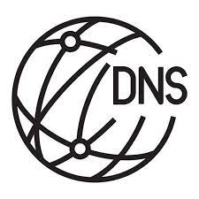
What is DNS?
Domain Name Service.
Map Domain Names with the IP Address.
52.19.167.6

Slide 4
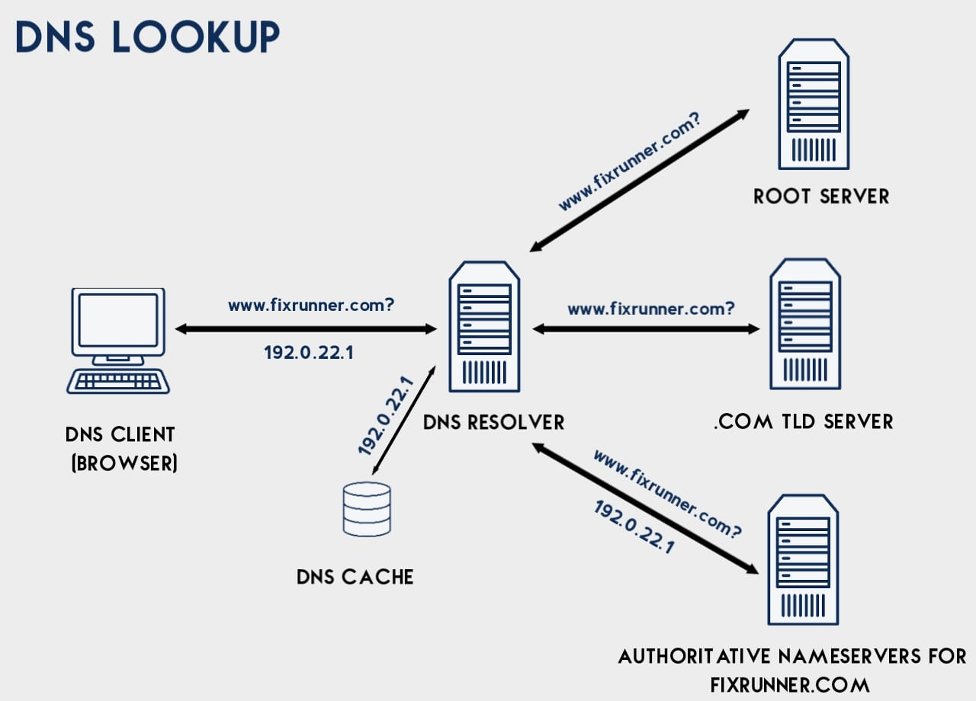
How DNS works?

Slide 5
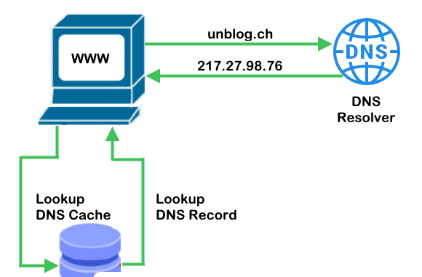
What is DNS Cache?

Slide 6
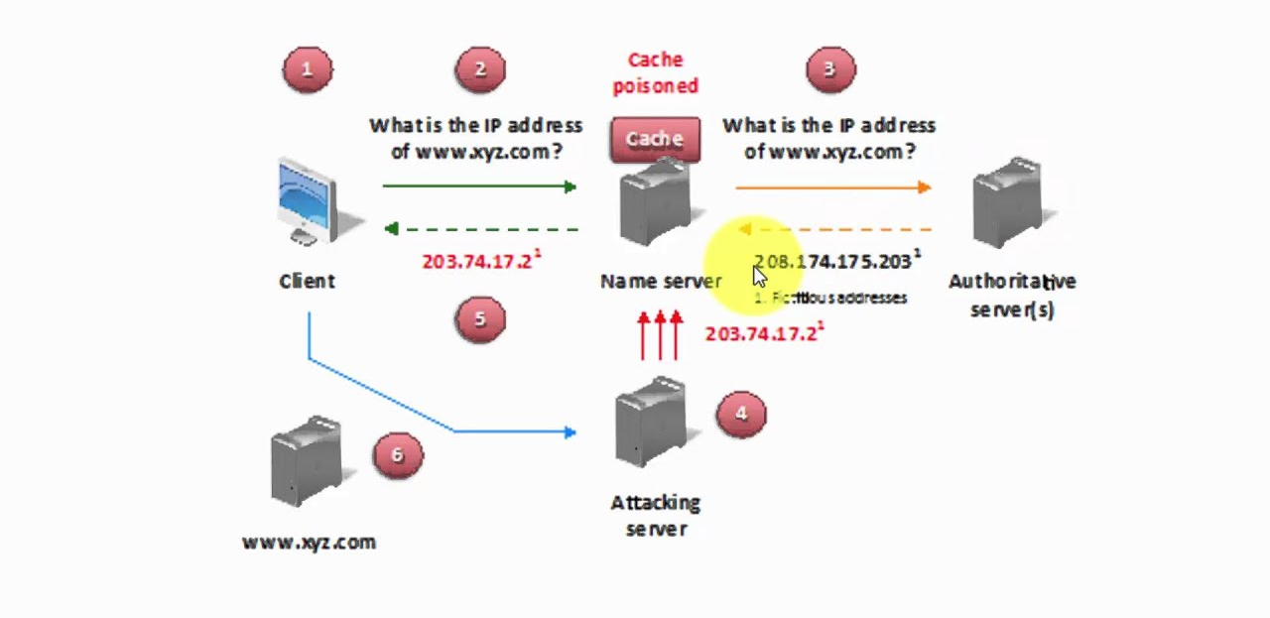
What is DNS Spoofing/Poisoning.

Slide 7
DNS Cache Poisoning Attack.

Slide 8
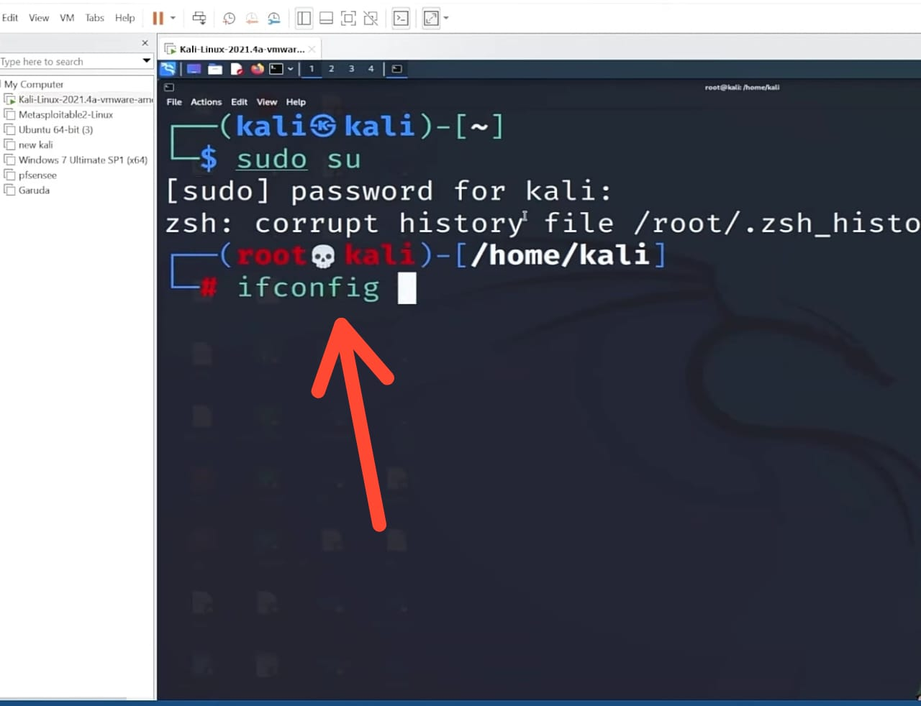

Slide 9
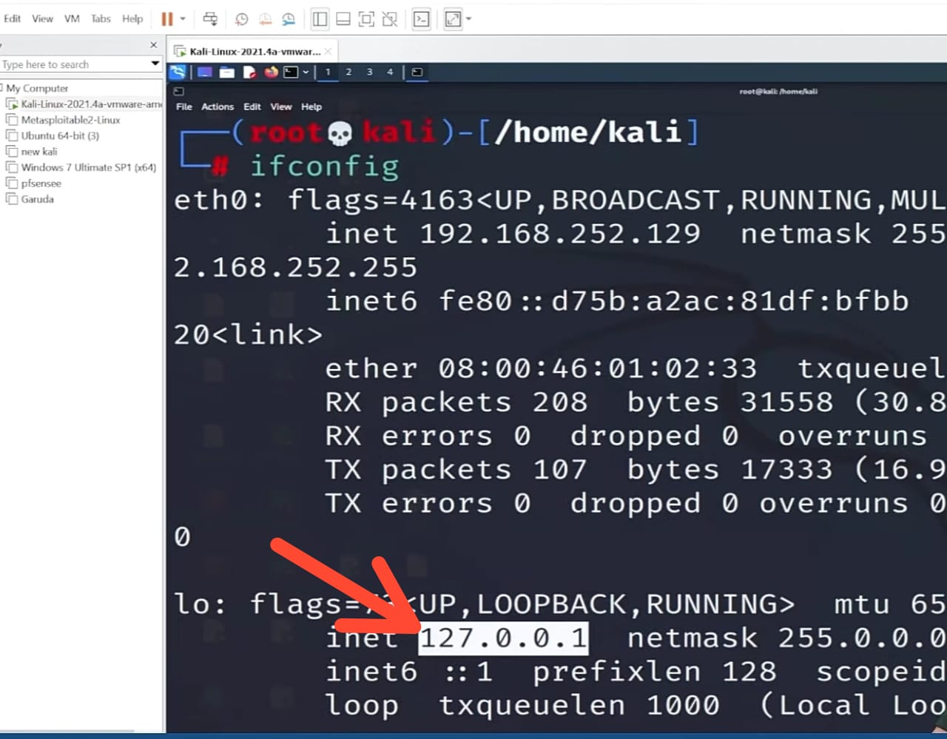

Slide 10
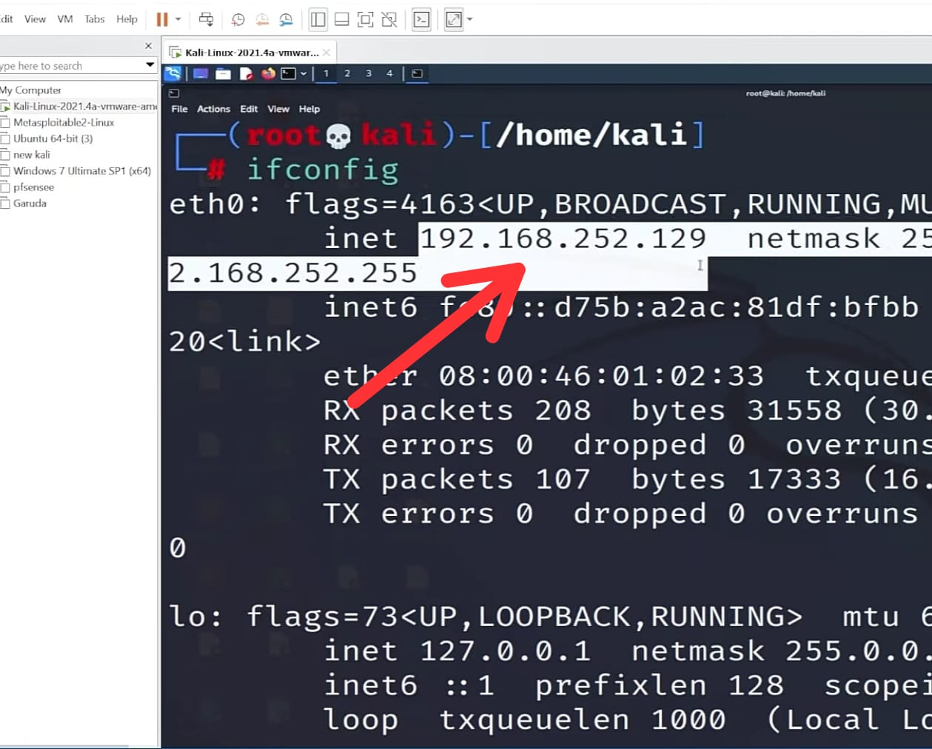

Slide 11
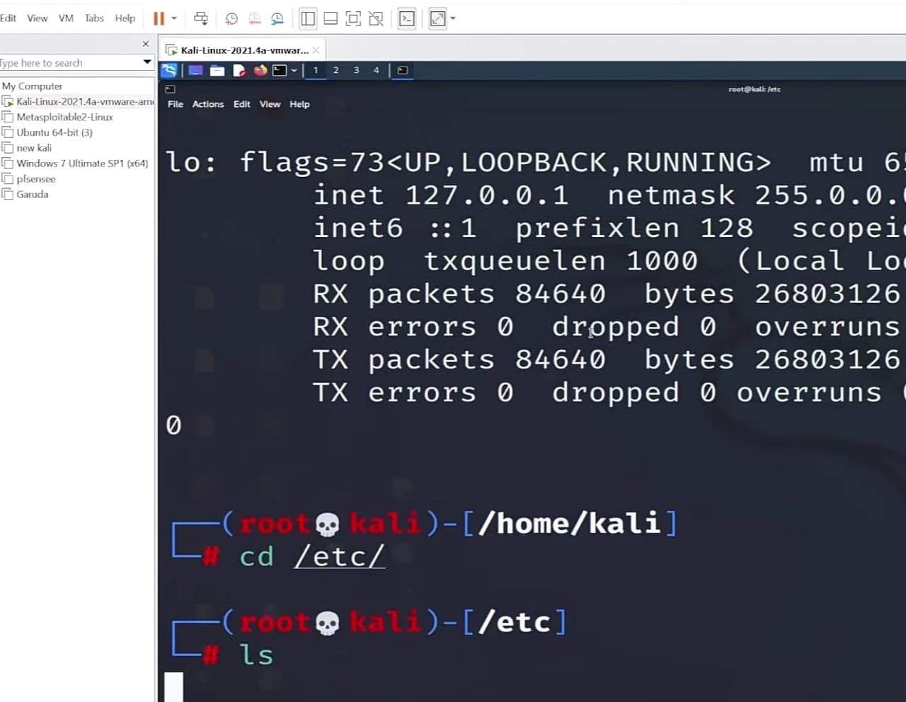

Slide 12
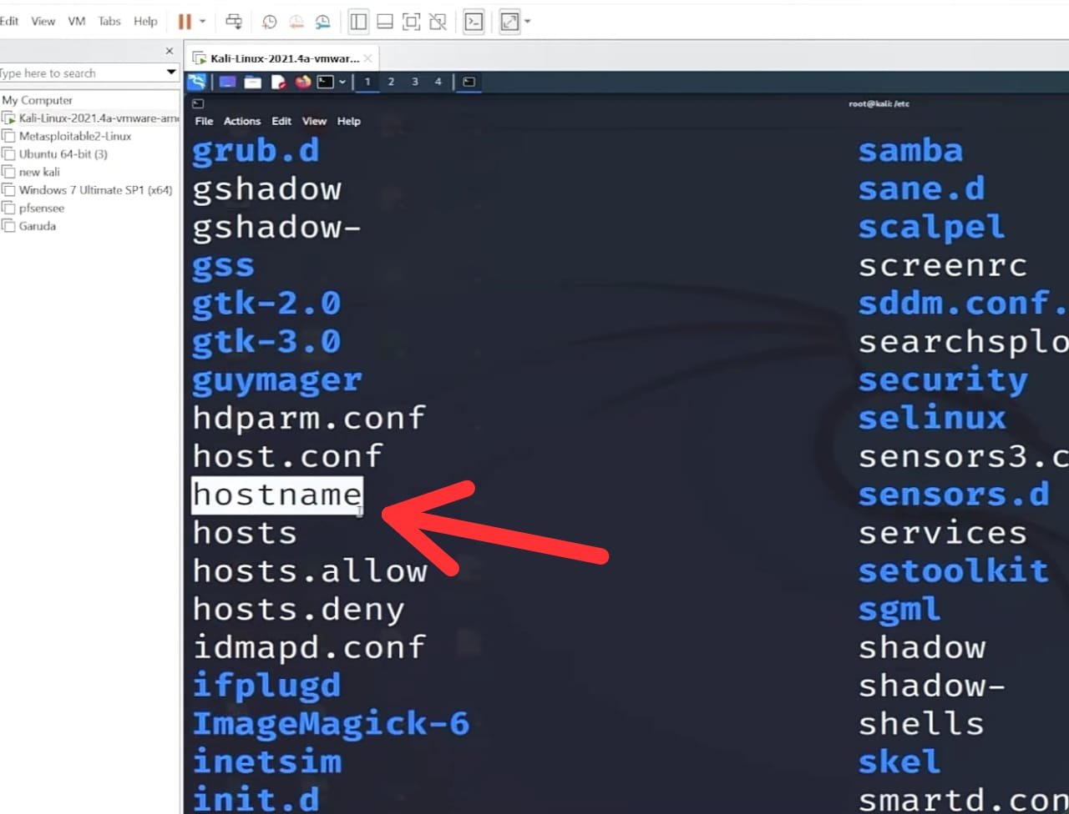

Slide 13
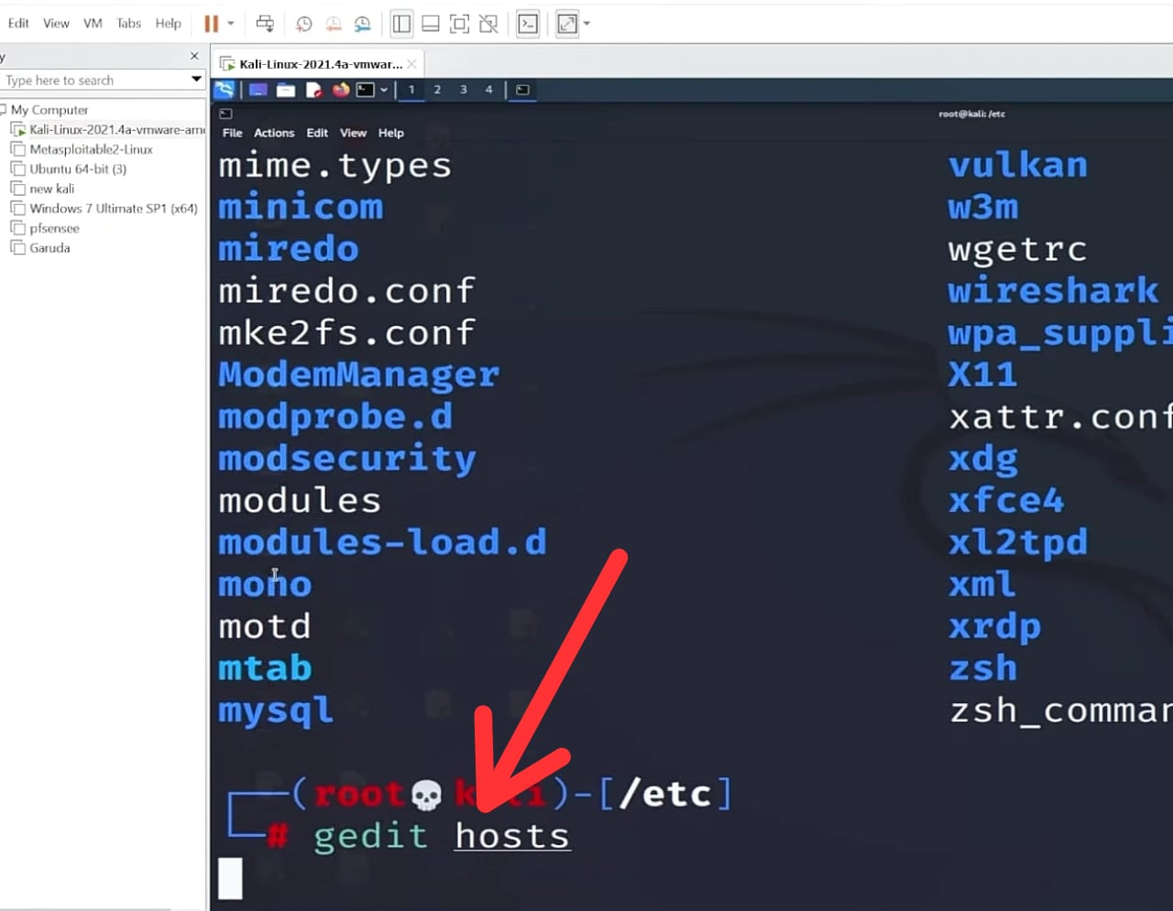

Slide 14
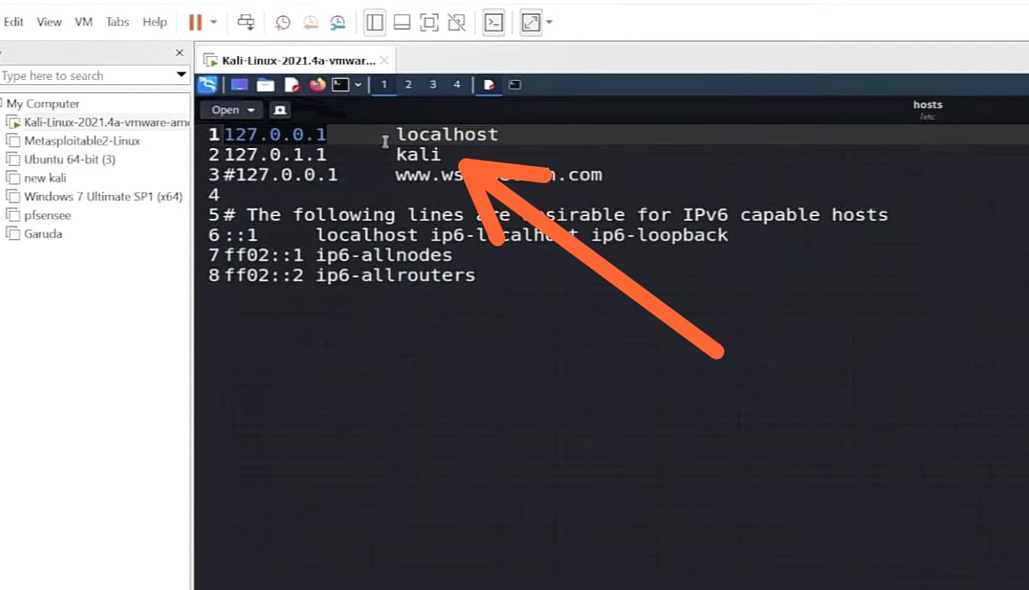

Slide 15
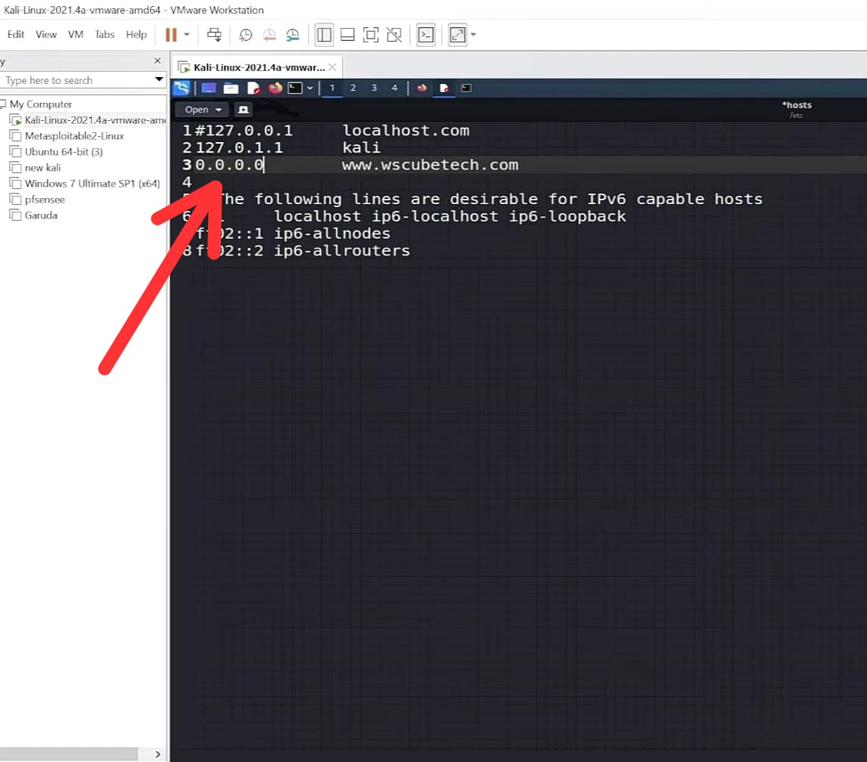

Slide 16
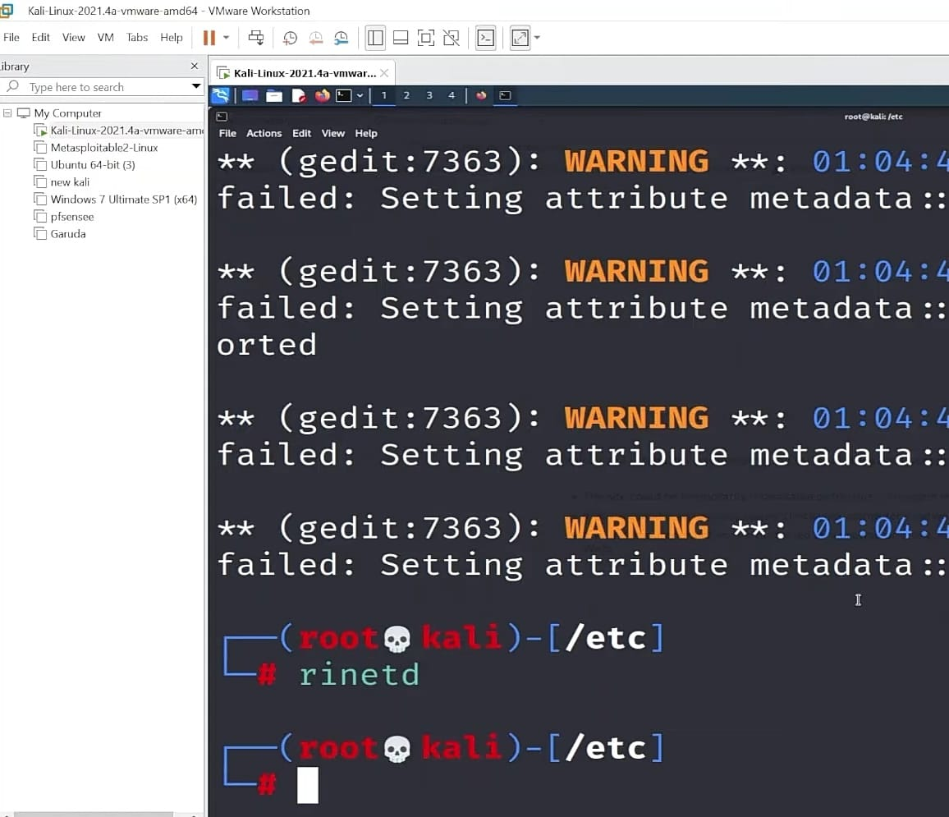

Slide 17
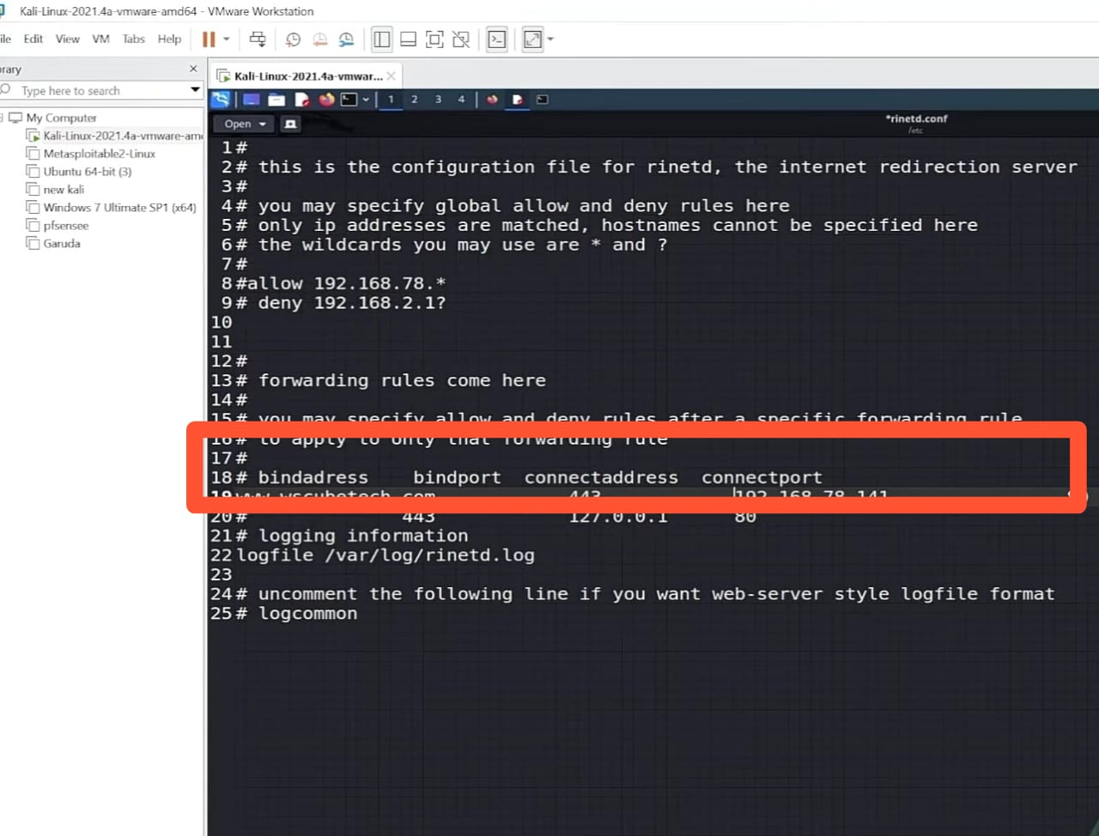

Slide 18
DNS Poisoning Tools.
There are some popular tools available that you can use.
Dnsspoof -> This tool navigates all the DNS to a fake local computer host file.
Ettercap -> It is one of the best tool for man in the middle attacks(MITM) and it provides DNS spoof, and a lot more option for MITM
Arpspoof -> This tool commands the IP address.

Slide 19
How To Prevent DNS POISING Attack?
There are several measures that you can take to prevent DNS cache poisoning and DNS spoofing attacks:
Use DNSSEC (Domain Name System Security Extensions) .
Implement DNS Response Rate Limiting (DNS RRL).
Use firewalls
Regularly update your DNS software
Monitor your DNS traffic:
Use a secure DNS resolver:
Use VPN (Virtual Private Network)

Slide 20
Methods to conduct DNS spoofing
There are a few methods to conduct DNS poisoning and spoofing, including:
Compromising a DNS server: An attacker directly hijacks a DNS server to reroute traffic from legitimate sites to other IP addresses.
Man in the middle attacks: An attacker positions themselves between your browser and a DNS server to route you from to a malicious IP address.
DNS cache poisoning: is the act of entering false information into a DNS cache, so that DNS queries return an incorrect response and users are directed to the wrong websites.

Slide 21
Aims of attackers
Launch an attack: By changing the IP address for a popular domain like Google.com, for example, a hacker could divert a large amount of traffic to a server incapable of handling so much traffic.
Redirection: A corrupted DNS entry can redirect users to website they do not intend to visit. A hacker might use this to send victims to a phishing site.
Censorship: Browsing the web is nearly impossible without DNS, so whoever controls the DNS server controls the DNS server controls who seen what on the web.

Slide 22
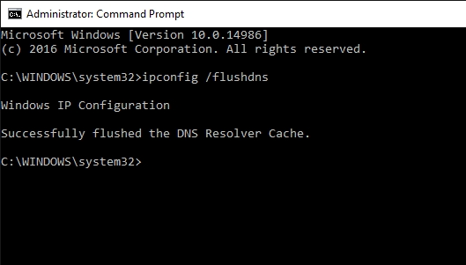
How to remove Poison?

